Slide 1

18CSC202J - OBJECT ORIENTED DESIGN AND PROGRAMMING
Session 7
Topic :throw, throws and finally

Slide 2
throwing Exception
When an exception is detected, it is thrown using throw statement in the try block
It is also possible, where we have nested try-catch statement
throw;
It cause the current exception to be thrown to the next enclosing try/catch sequence and is caught by a catch statement listed after that enclosing try block.

Slide 3
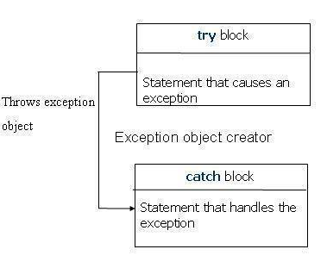
throwing Exception

Slide 4
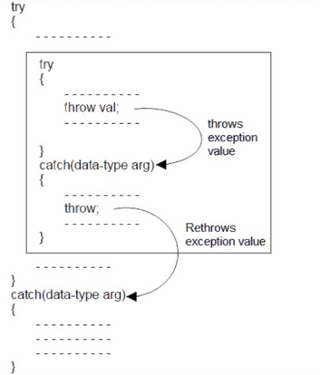
Rethrowing Exception

Slide 5
The throw point
Used to indicate that an exception has occurred
It is called “throwing an exception”
Throw normally specifies an operand:
Will be caught by closest exception handler

Slide 6
The throw point: Example
try
{
if(denominator == 0)
{
throw denominator;
}
result = numerator/denominator;
cout<<"\nThe result of division is:" <<result;
}

Slide 7
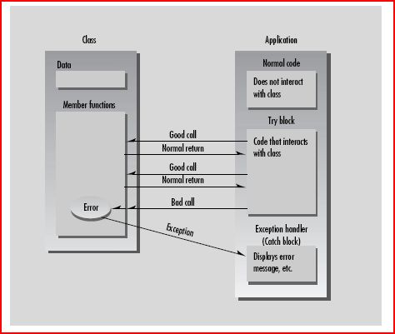

Slide 8
Finally
The application always executes any statements in the finally part, even if an exception occurs in the try block. When any code in the try block raises an exception, execution halts at that point.
Once an exception handler is found, execution jumps to the finally part. After the finally part executes, the exception handler is called.
If no exception occurs, the code in the finally block executes in the normal order, after all the statements in the try block.

Slide 9
Syntax
try
{
// statements that may raise an exception
}
__finally
{
// statements that are called even
//if there is an exception in the try block
}

Slide 10
Example
else
{
throw(b);
}
}
catch(int i)
{
cout <<“exception caught”;
}
__finally
{
Cout<<“Division”;
}
}
#include<iostream>
using namespace std;
int main()
{
int a,b;
cin >> a>> b;
try
{
if (b!=0)
{
cout<<“result (a/b)=”<<a/b;
}

